Slide 1
PARKING SPACE DETECTION
PRANAV BANSOD

Slide 2
CONTENTS
01
Problem Statement
02
Dataset
03
Model Summary
04
Output

Slide 3
Problem Statement
How often you visit a shopping mall or any public place with parking amenities but end up finding all the parking slots full?
Especially on weekends, you go to visit a place and look for a parking area.
Lets say you find a public parking area and when you enter, you struggle to find an empty space for your car.
People end up wasting time and energy finding parking slot in an already completely occupied space.
This Deep Learning Object Detection Project focusses on this issue and provides a solution to keep track of how many empty slots are available to inform a car owner upfront before entering the parking area.

Slide 4
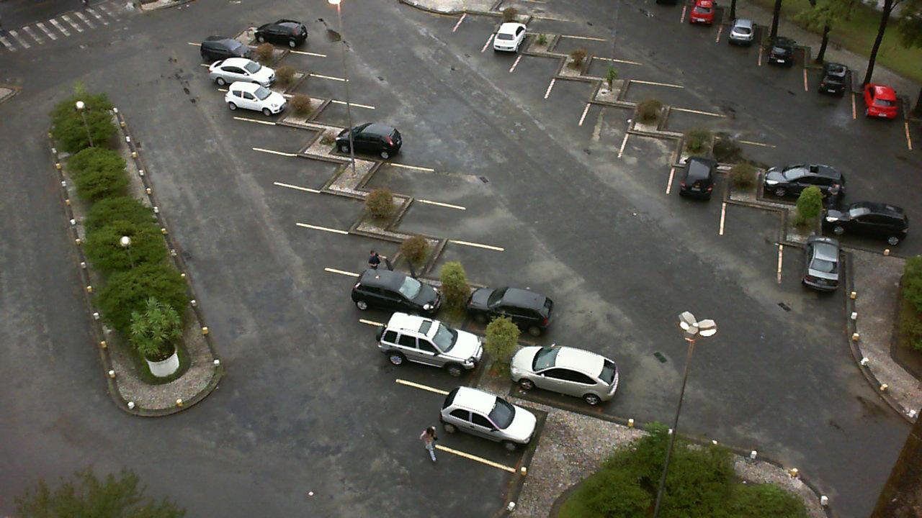
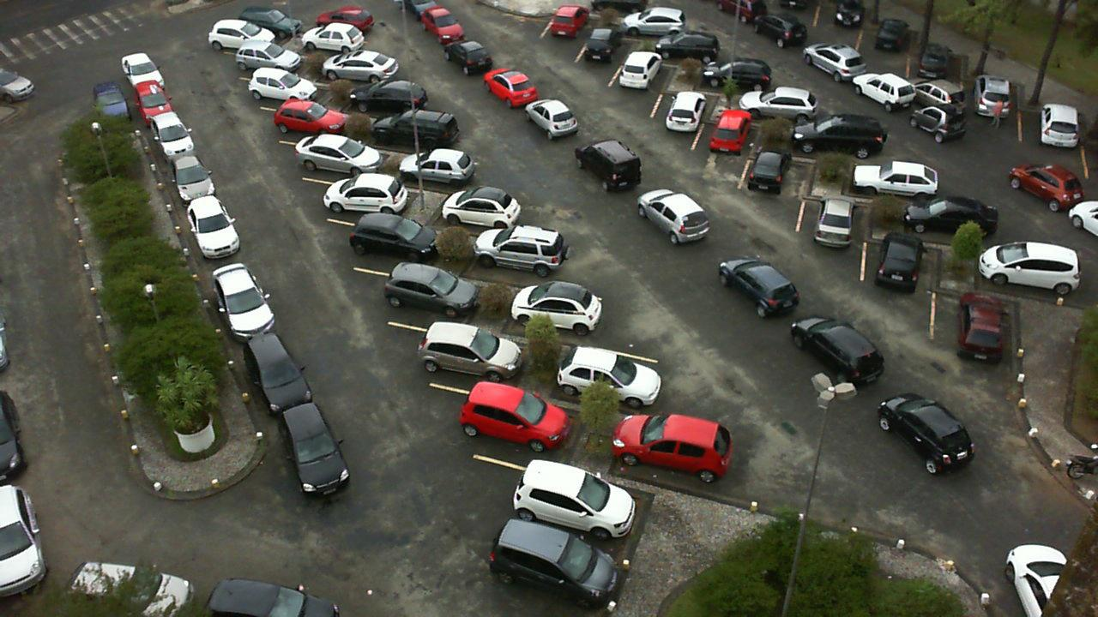
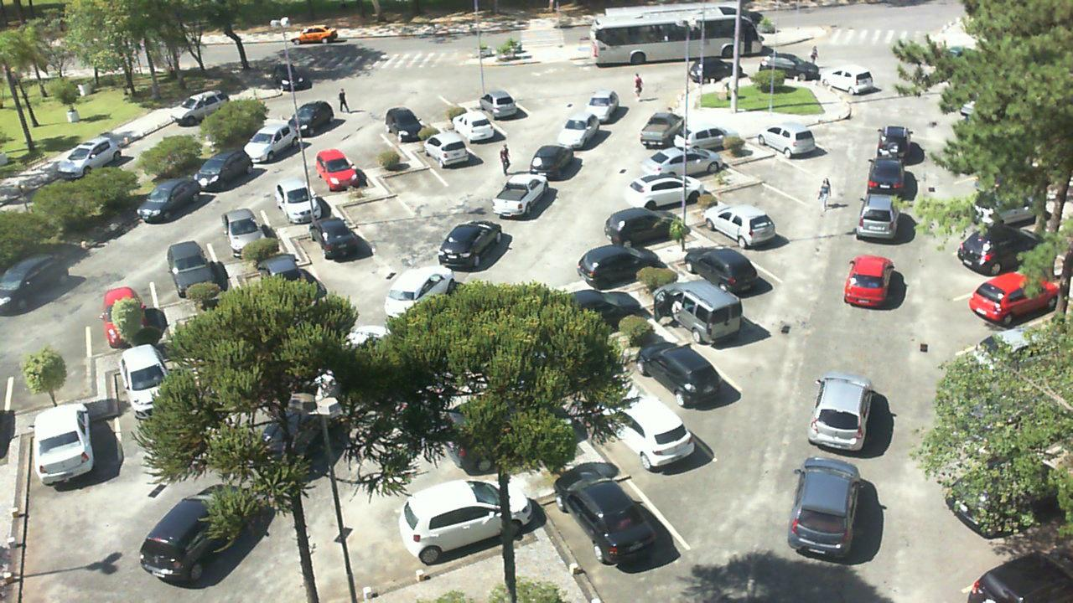
Dataset
12,416 images in total.
8695 training images.
2493 validation images
1,244 testing images.
https://public.roboflow.com/object-detection/pklot/1

Slide 5
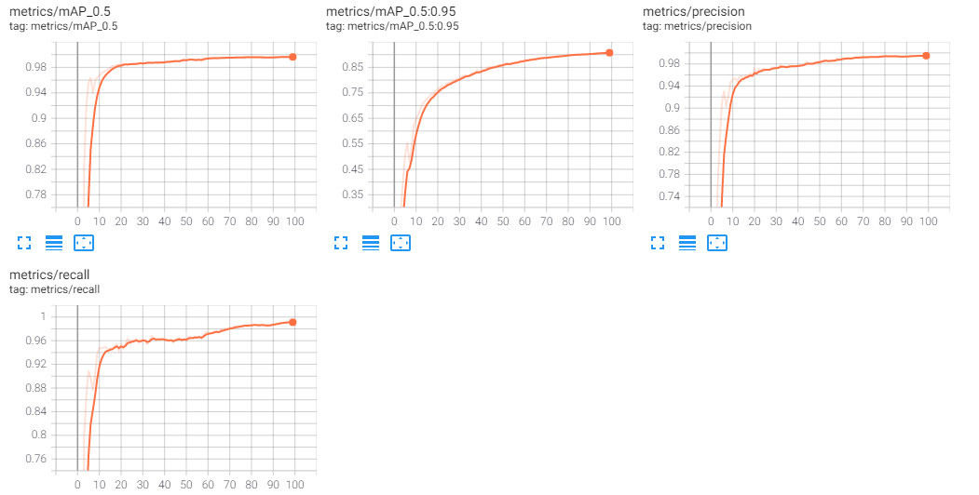
Model Summary
Fine-tuned Yolov5 Pretrained model on custom dataset.
Model Summary: 283 layers, 7257791 parameters, 7257791 gradients, 16.8 GFLOPs
Fine-tuned to train on 100 epochs with batch size 64

Slide 6
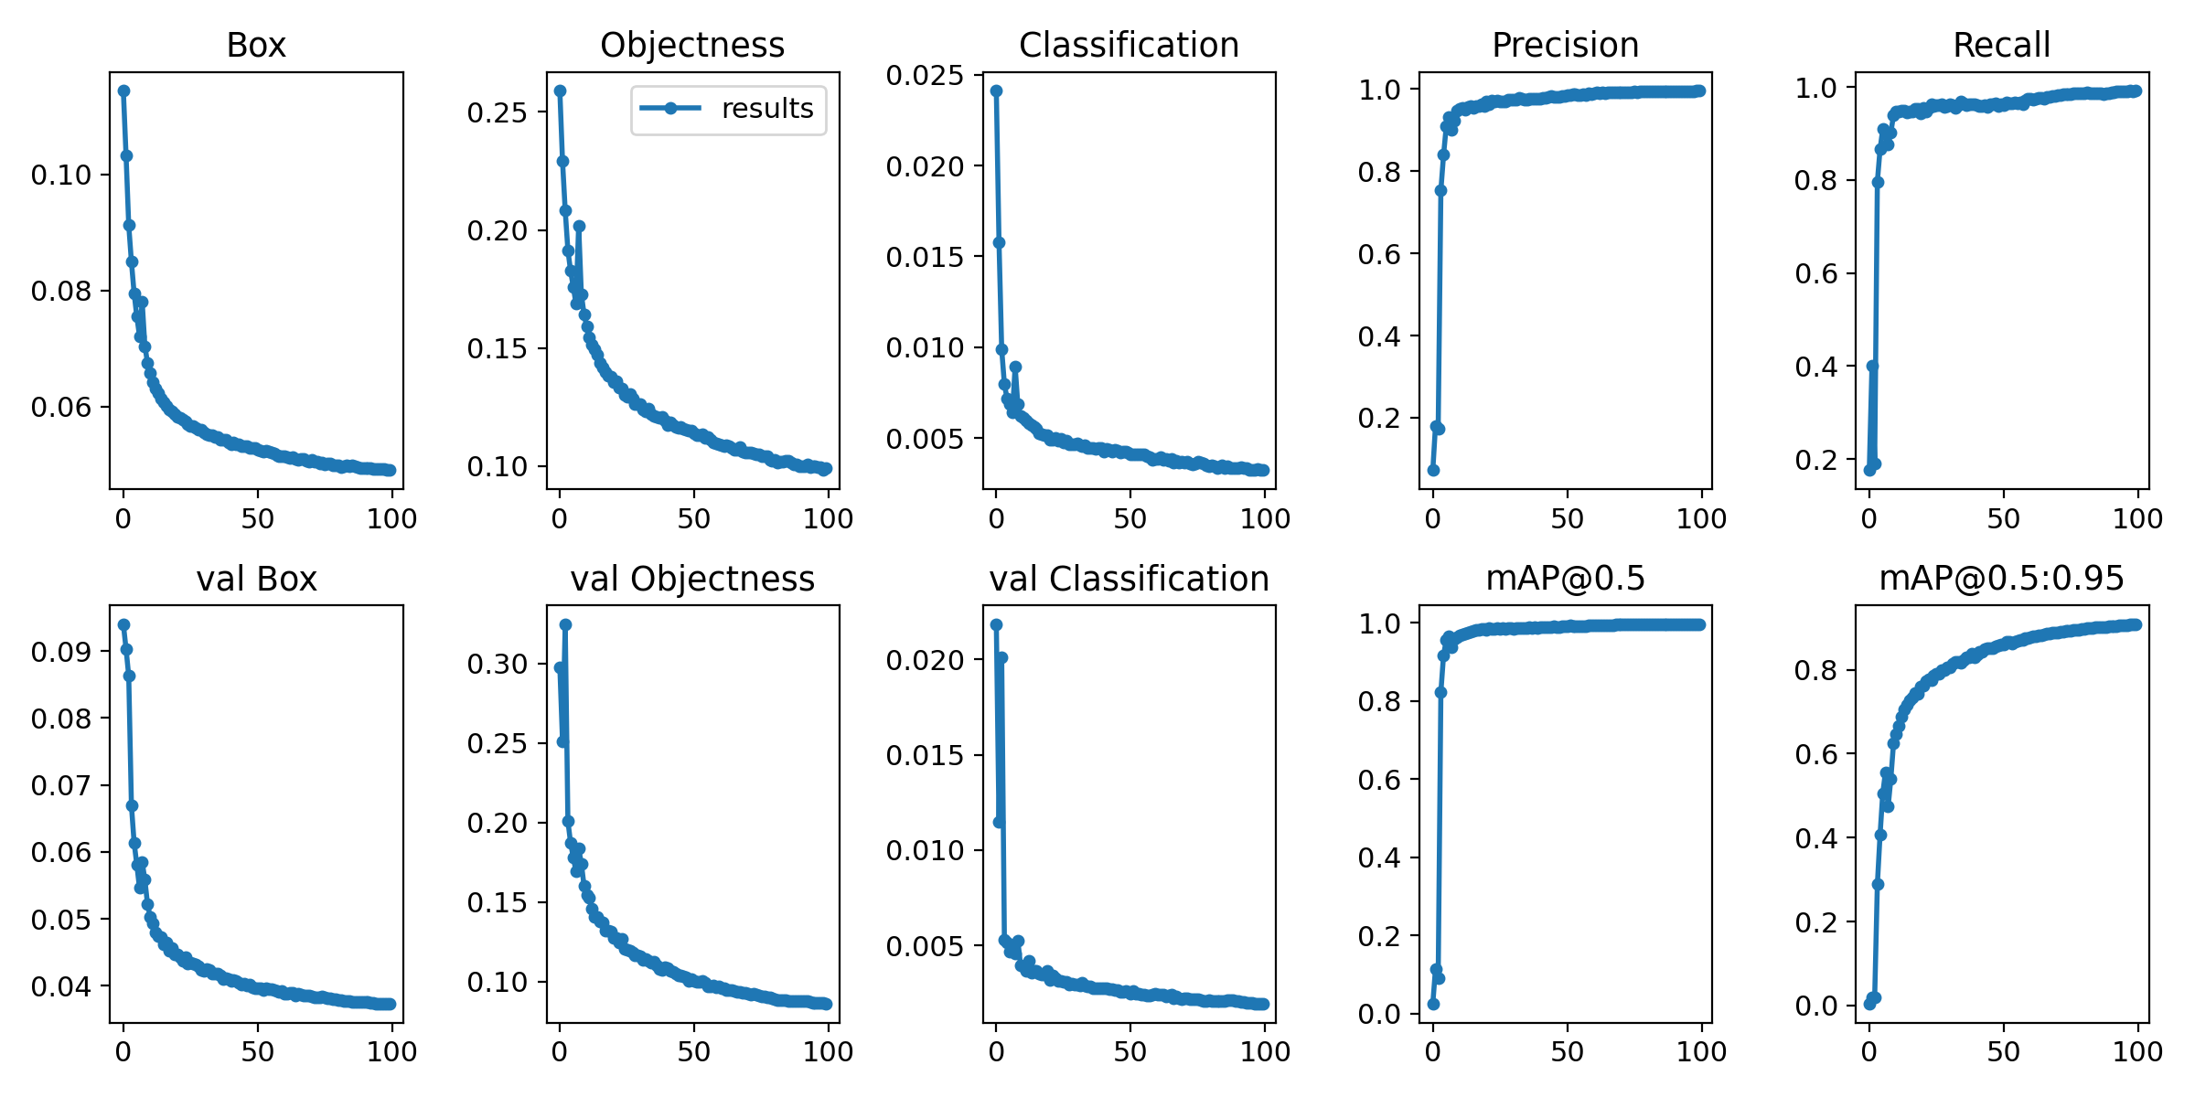
Model Summary
You want to take the trained model weights at the point where the validation mAP reaches its highest.

Slide 7
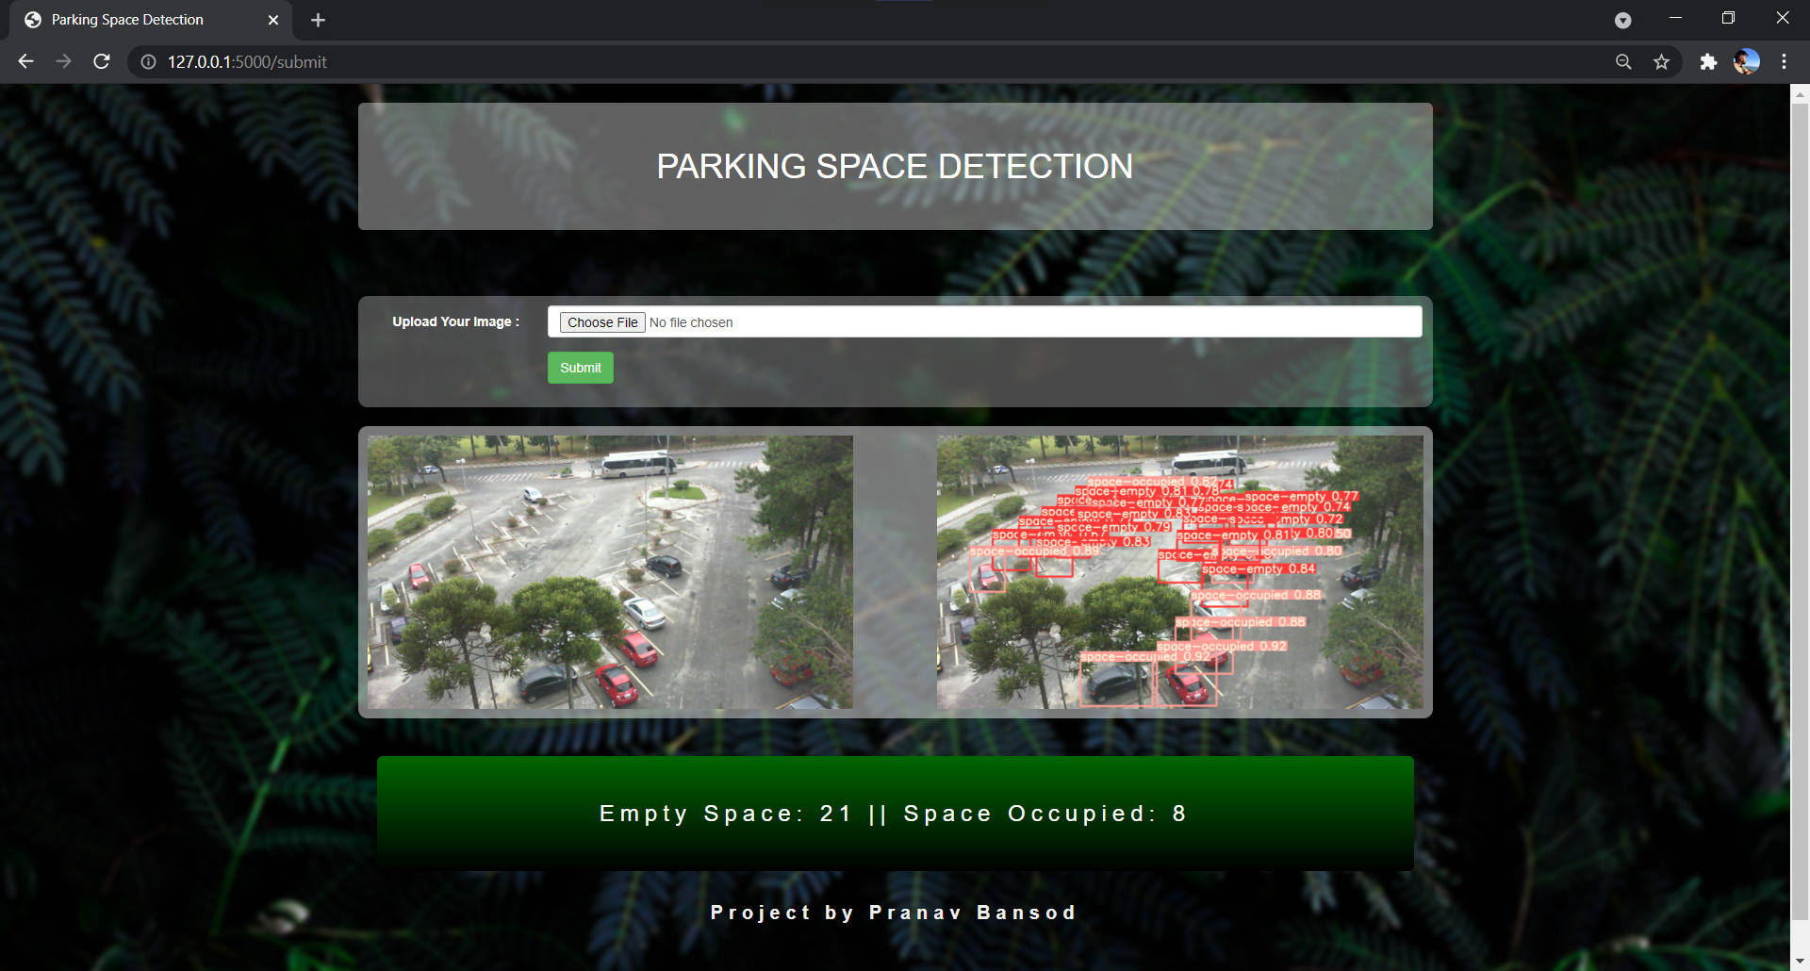
Output

Slide 8
THANK YOU

